Slide 1
Noise Pollution

Slide 2
Sound
Sound refers to only those vibrations with frequencies that are within the range of hearing for human.

Slide 3
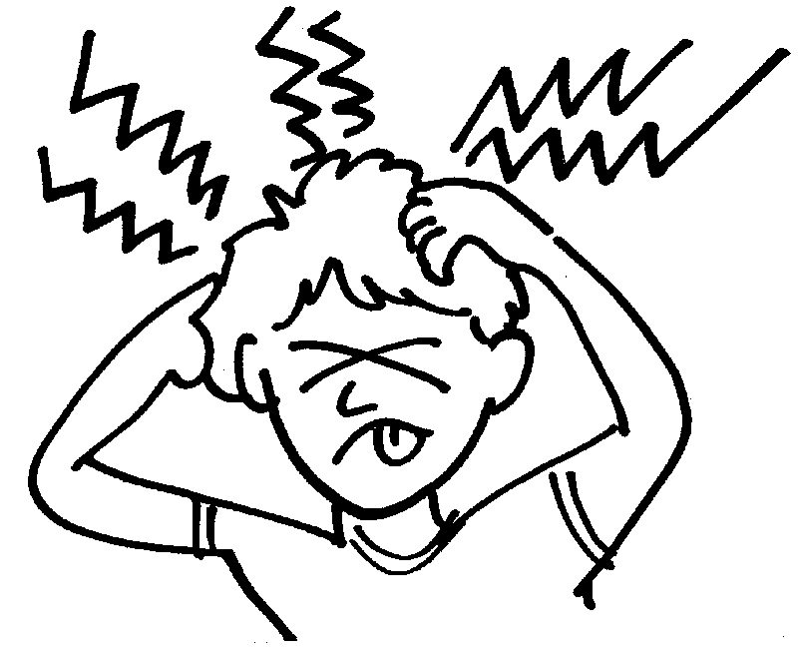
Noise
“Noise is define as any undesirable human or machine created noise which disturbs the activity or balance of human or animal life”.

Slide 4
Noise Pollution
Noise pollution refers to a type of energy pollution in which distracting, irritating or damaging sounds are freely audible.
In this type of pollution contaminants are not physical particles, but waves which interfere with the naturally occurring waves of a similar type in the same environment.

Slide 5
Terminology used in noise pollution
Frequency: Frequency is the no of cycles repeated in unit time duration. Its unit is cycle/sec or Hz ( 1 Hz= 1 Cycle /sec)
Intensity: Amount of sound energy received / sec is known as intensity of sound. Its Unit is decibel ( dB).
Sounds produced by all vibrating bodies are not audible. The frequency limits of audibility are from 20 HZ to 20,000 HZ.

Slide 6
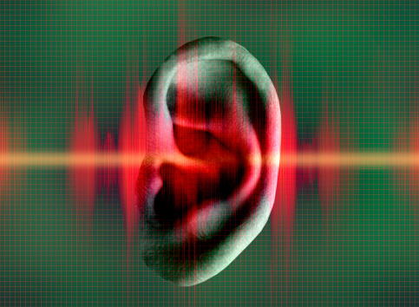
Measurement of Noise ( Sound)
Decibel: Decibel is define as the logarithm to the base 10 to ratio of two intensities
Lt=10 log ₁₀ (I/I₀) dB
Where, I= Measured Intensity
I₀= Reference Intensity
L_{t}= Level of noise in dB

Slide 7
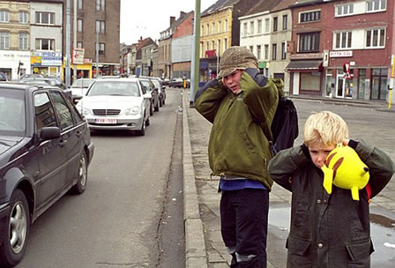
Sources Of Noise
Major Sources of Noise:
Traffic Noise: Automobile revolution in urban areas are proved to be a big source of noise pollution. Increase in traffic has given rise to traffic jams, where the repeated hooting of horns by drivers create noise pollution. Air crafts creates serious problems in big cities like Mumbai & Delhi
Heavy truck, buses, trains, motorcycles, jeeps, other vehicles are responsible for traffic noise.

Slide 8
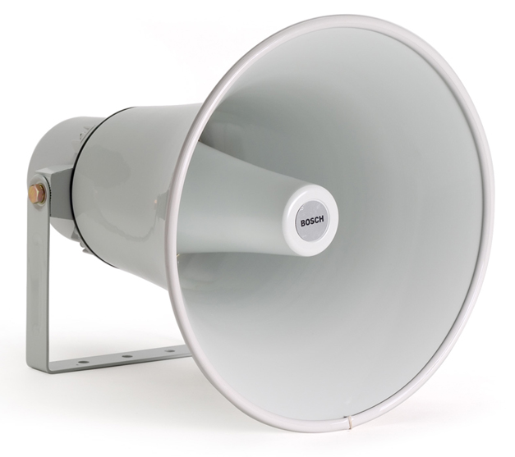
Industrial And Construction Machinery Noise:-
Factory equipments, generators, drills, road rollers, and similar machinery also make lot of noise.
Public address System:- Public system contribute in its own ways towards noise pollution by using loud speakers for religious functions, birth, marriage, election for commercial advertising
Household:- The household activities will contribute for indoor noise pollution domestic gadgets like pressure cookers, A.C, Vacuum cleaners, mixers, washing machines are major source of noise at house hold level. Entertainment equipments like radio, music system, T.V. Will contribute toward noise pollution

Slide 9
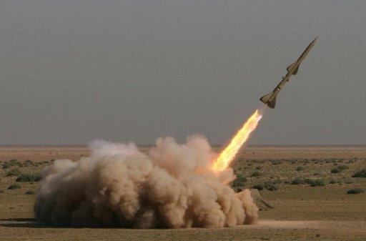
Defense Exercises:- Tanks, launching of rockets, explosion, military exercises, aero planes, shooting ranges are adding toward noise pollution.

Slide 10
Typical noise levels of some point sources

Slide 11
Effects of Noise pollution
Noise can do Physiological and or / Psychological damage if the volume is high or if exposure is prolonged.
Common effects of Noise pollution are:
Hearing Loss: Loud noise damages fine hair cell in the ear. The vibration of these hair cells is responsible for hearing of Sound by us, Since our body cannot replace damaged hair cells. Permanent Hearing loss is caused by long term exposure to loud noise.

Slide 12
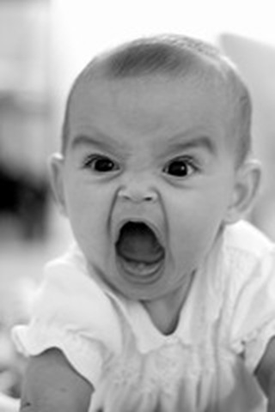
Annoyance: It creates annoyance to the receptor due to sound level fluctuations
Physiological effects:
The Physiological effects like breathing difficulty, rise in blood pressure, migraine, headaches, constriction of blood vessels and even heart attacks.
.

Slide 13
Effects of Noise pollution
Human performance: The working of humans will be affected as they will lose their concentration
Nervous System: It causes pain ringing in ears, feeling of tiredness, thereby effecting functioning of human system

Slide 14
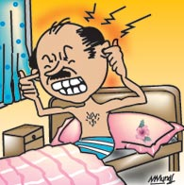
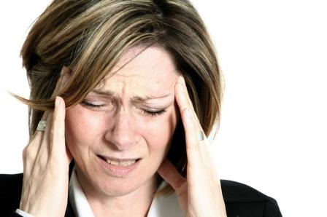
Sleeplessness: It affects the sleeping thereby inducing the people to become restless and loose concentration and presence of mind during their activities.

Slide 15
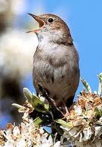
Effects on animals
Noise can cause serious damage to wild life. Ways in which animals are adversely affected by noise pollution includes.
Hearing loss
Masking: Masking is the inability to hear important environmental clues and animal signals
Physiological effects: such as increase in heart rate, respiratory difficulties and stress.
Behavioral effects:-Which could result in abandonment of territory and loss of ability to reproduce.
Ecological effects: It leads to migration of birds which disturbs the ecosystem

Slide 16
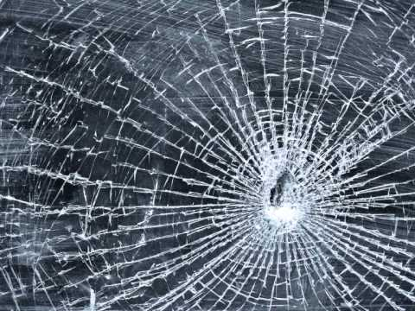
Effects on plants
The production capacity or growth of plant is affected due to high level noise.
Damage to material:
The building and material may get damage by exposure to infrasonic/ ultrasonic waves and even get collapsed.

Slide 17
Control of Noise Pollution
Noise is not only a nuisance but a serious environmental problem and a health hazard. Like all other pollution, noise pollution is needed to be controlled.
Noise pollution can be effectively controlled by taking following measures.

Slide 18
Noise Abatement / Control
A noise problem generally consists of three inter-related elements- the source, the receiver and the transmission path. This transmission path is usually the atmosphere through which the sound is propagated, but can include the structural materials of any building containing the receiver

Slide 19
The Sound of Human Speech is mainly in the range of 300 to 3000 Hz

Slide 20
Control of Noise Pollution
Control at receivers end
For people working in noisy areas ear protection aids like ear plugs, muffs, noise helmets, head phones etc should be provided it reduces occupational exposure.
Controlling at source
This is only possible if working method is improved.
Design new machines to replace noisy ones. Proper lubrication and better, maintenance of machines. Installing noisy machines with sound absorbing materials. Using Silencer to control noise from automobiles etc.

Slide 21
Zoning
Increased distance between source and receiver by zoning of noisy industrial areas like bus stand and railway stations away from silence zones near residential areas, educational institutions and hospitals.
Sound Insulation
A) Sound insulations can be done by constructing windows with more than one panes of glass and filling the gap with sound absorbing material.
B) Acoustical tiles, perforated plywood can be fixed on wall, ceilings, floors to reduce noise.

Slide 22
Control of Noise Pollution
Planting of Trees
Planting of trees and shrubs along roads, hospitals, educational institutions help in noise reduction to a considerable extent.
Legislative measures
Strict legislative measures need to be enforced to control the nuisance of noise pollution some of the measures are
A) Minimum use of loud speakers, near silence zones.
B) Banning Pressure horns in automobiles
C) Framing a separate noise pollution act.

Slide 23
Sound level for human response

Slide 24
Damage risk criteria for hearing loss (OSHA regulations)
OSHA- Occupational Safety and Health Administration

Slide 25
Indian Standards for ambient noise levels

Slide 26
Thank you

